Slide 1
Block Coding
Block coding changes a block of ‘m’ bits into a block of ‘n’ bits (n>m)
mB/nB encoding
technique
We need Redundancy to ensure Synchronization
Block coding gives us redundancy and improves line coding performance

Slide 2
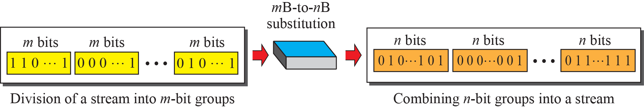
Block coding concept

Slide 3
Block Coding
Block coding changes a block of ‘m’ bits into a block of ‘n’ bits (n>m)
mB/nB encoding
technique
We need Redundancy to ensure Synchronization
Block coding gives us redundancy and improves line coding performance

Slide 4
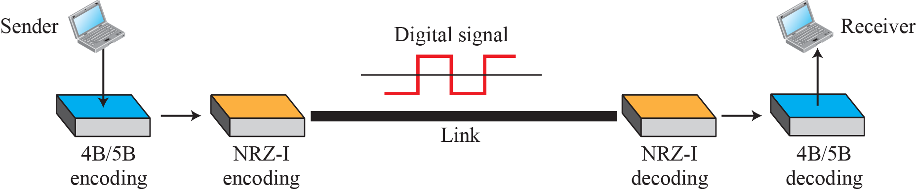
Using block coding 4B/5B with NRZ-I line coding

Slide 5
Block Coding
Block coding changes a block of ‘m’ bits into a block of ‘n’ bits (n>m)
mB/nB encoding
technique
We need Redundancy to ensure Synchronization
Block coding gives us redundancy and improves line coding performance

Slide 6
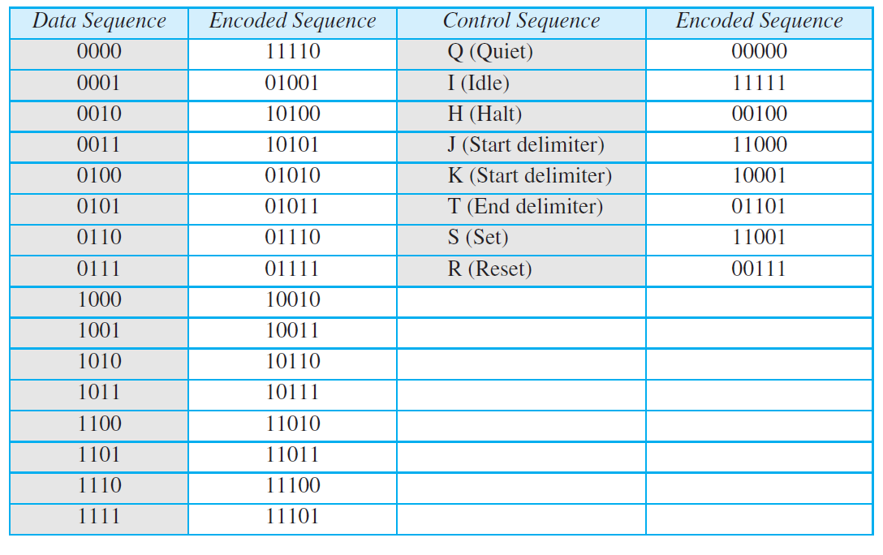
4B/5B mapping codes

Slide 7
Block Coding
Block coding changes a block of ‘m’ bits into a block of ‘n’ bits (n>m)
mB/nB encoding
technique
We need Redundancy to ensure Synchronization
Block coding gives us redundancy and improves line coding performance

Slide 8
Example
We need to send data at a 1-Mbps rate. What is the minimum required bandwidth, using a combination of 4B/5B and NRZ-I or Manchester coding?

Slide 9
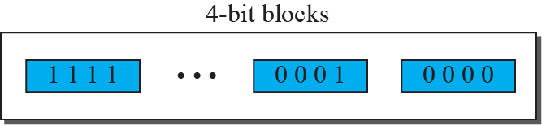
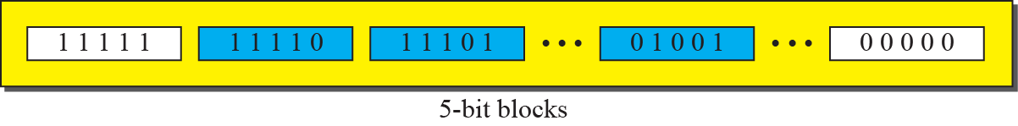
Example

Slide 10
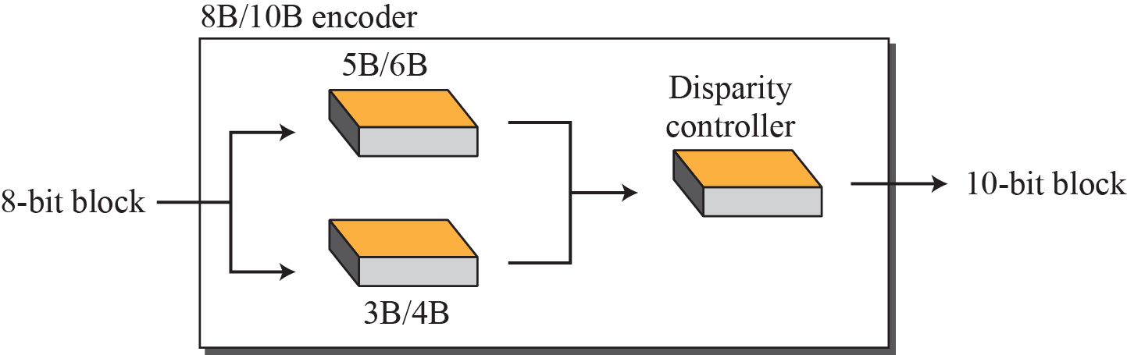
8B/10B block encoding

Slide 11
Scrambling
Biphase schemes suitable for LAN but not for Long Distance
Block Coding + NRZ-I solves synch issue but has DC component
Bipolar AMI has a narrow bandwidth (no DC Component) but synch issue (long series of 0s)

Slide 12
Scrambling
The system needs to insert the required pulses based on the defined scrambling rules

Slide 13
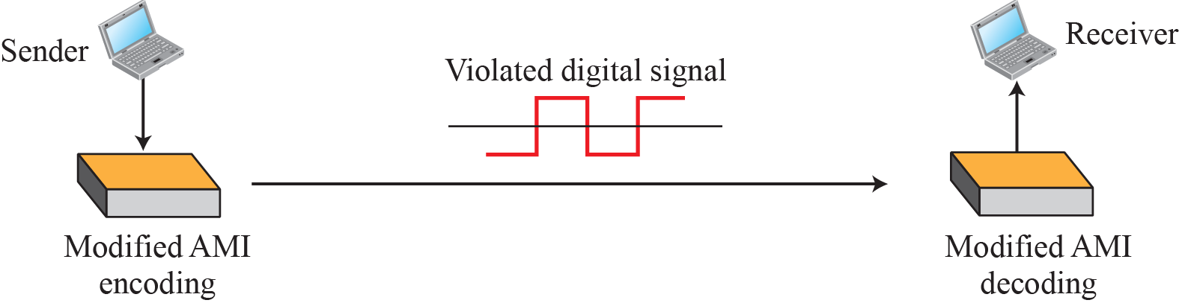
AMI used with scrambling

Slide 14
Types of Scrambling Techniques
Two common scrambling techniques are B8ZS and HDB3
Bipolar with 8-Zero Substitution (B8ZS)
High-density bipolar 3-zero (HDB3)

Slide 15
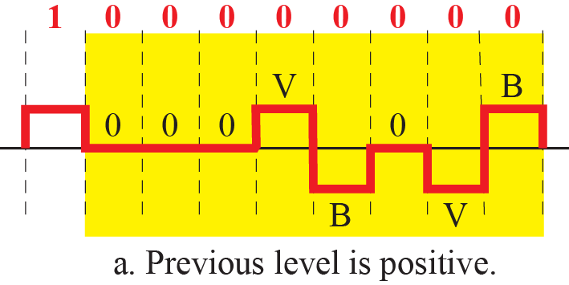
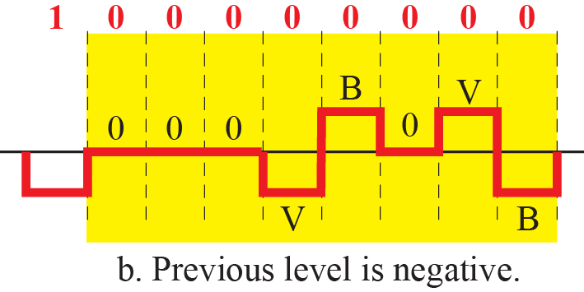
Two cases of B8ZS scrambling technique

Slide 16
Types of Scrambling Techniques
Two common scrambling techniques are B8ZS and HDB3
Bipolar with 8-Zero Substitution (B8ZS)
High-density bipolar 3-zero (HDB3)

Slide 17
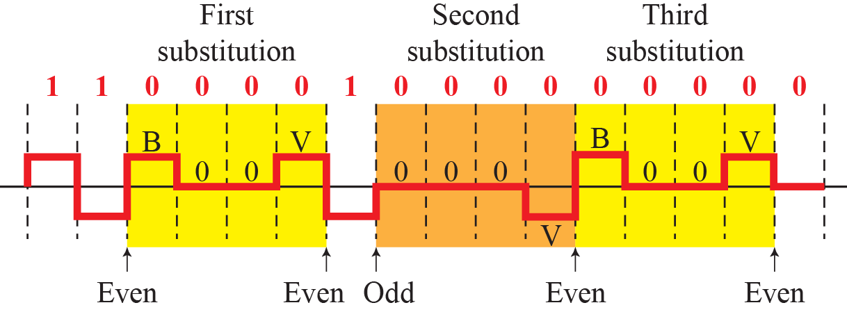
Different situations in HDB3 scrambling technique

Slide 18
Analog-to-digital Conversion
Analog Data to Digital Data
Process of Digitization
Two techniques:
Pulse Code Modulation (PCM)
Delta Modulation (DM)

Slide 19
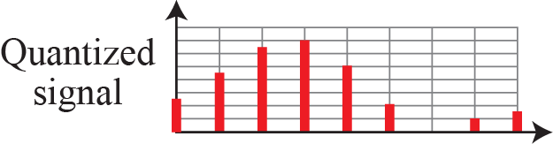
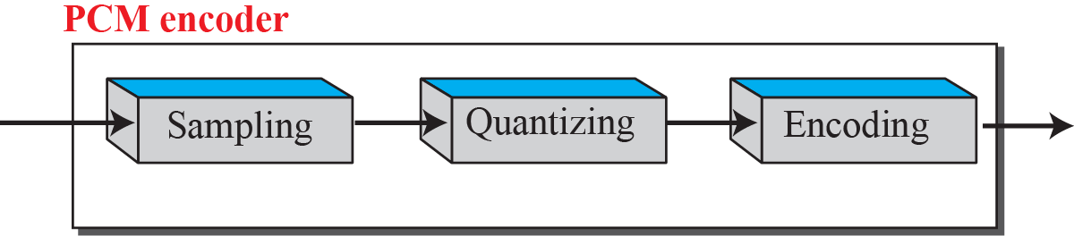
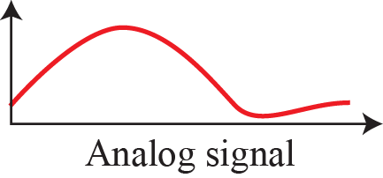
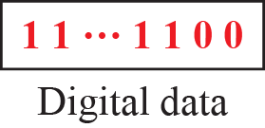
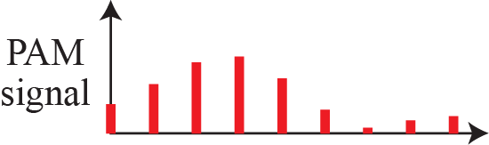
Pulse Code Modulation (PCM)

Slide 20
Pulse Code Modulation (PCM)
Sampling
Quantization
Encoding

Slide 21
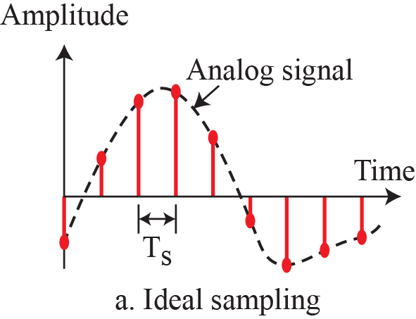
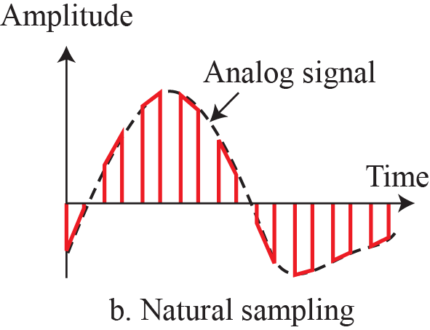
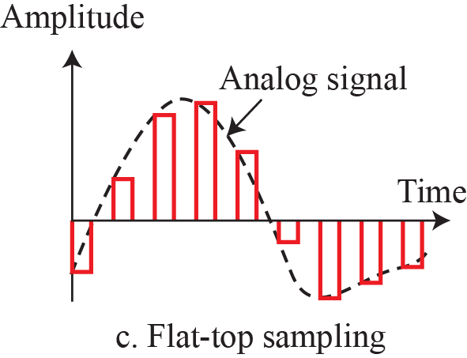
Three different sampling methods for PCM

Slide 22
Nyquist Sampling Rate
Nyquist → fs = 2fh
Sampling sine wave at three sampling rates:
f_{s} = 4f (2 times the Nyquist rate)
f_{s} = 2f (Nyquist rate)
fs = f (one-half the Nyquist rate)

Slide 23
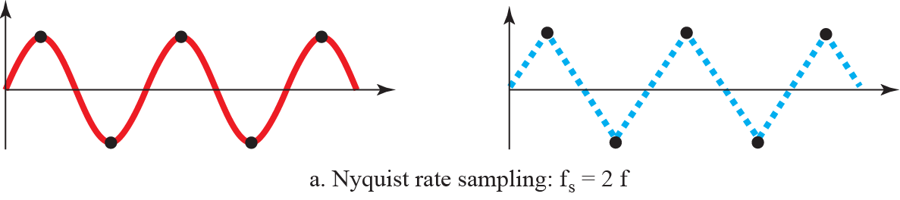
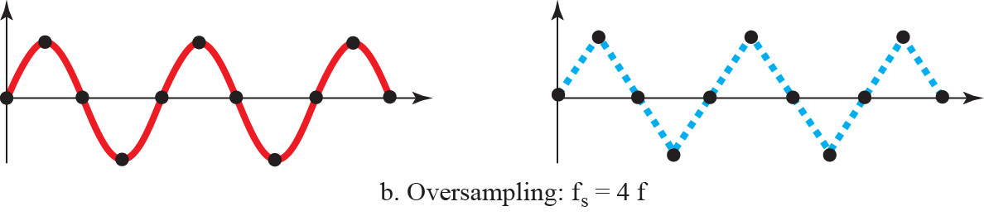
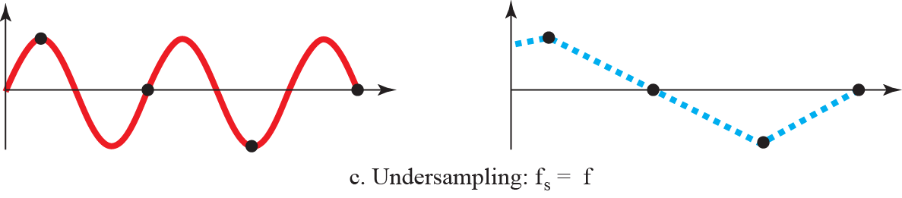
Nyquist Sampling Rate

Slide 24
Pulse Code Modulation (PCM)
Most common technique
Employs a PCM Encoder
A PCM encoder has three processes:
Sampling
Quantization
Encoding

Slide 25
Components of PCM encoder

Slide 26
Pulse Code Modulation (PCM)
Sampling
Quantization
Encoding

Slide 27
Quantization & encoding of a sampled signal
Sampling → Series of pulses with amplitude values between min and max signal amplitude
Infinite set with non-integral values not suitable for encoding
We quantize the sampling output into certain levels based on range of amplitudes and how much accuracy is needed

Slide 28
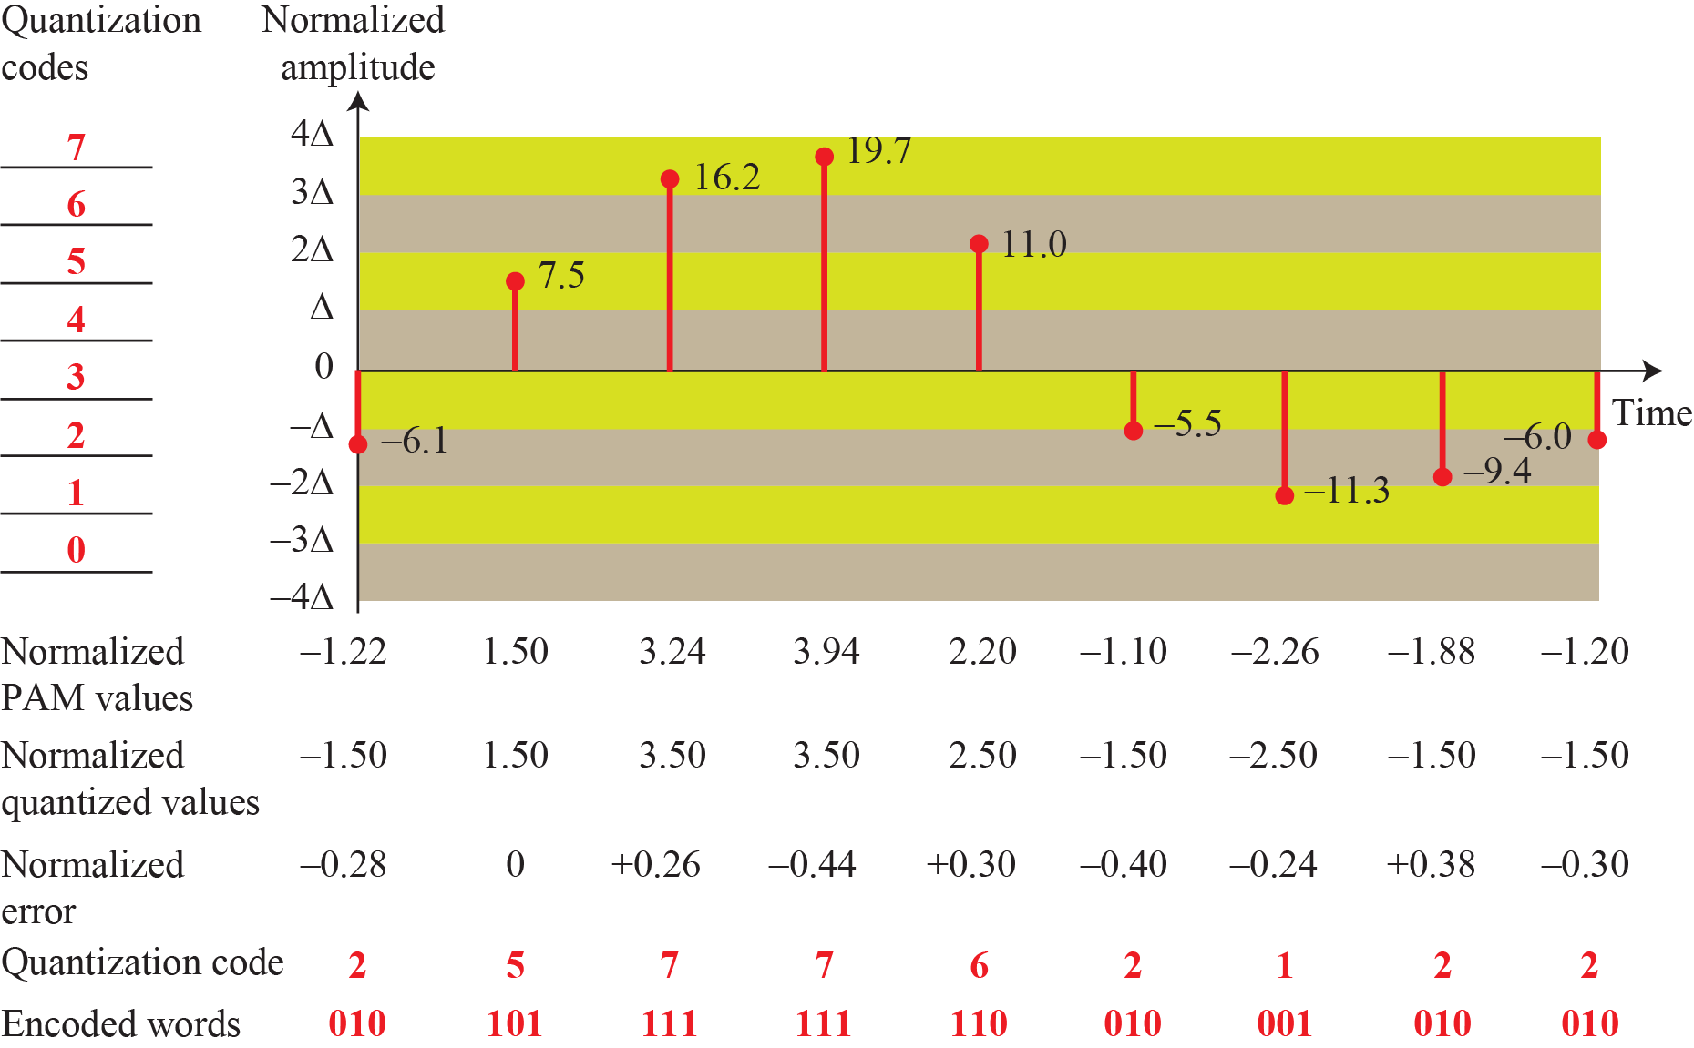
Quantization & encoding of a sampled signal

Slide 29
Pulse Code Modulation (PCM)
Encoding
Sampling
Quantization
Encoding
Decoding

Slide 30
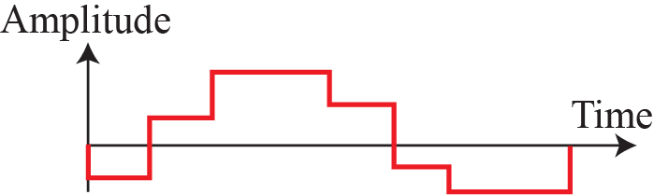
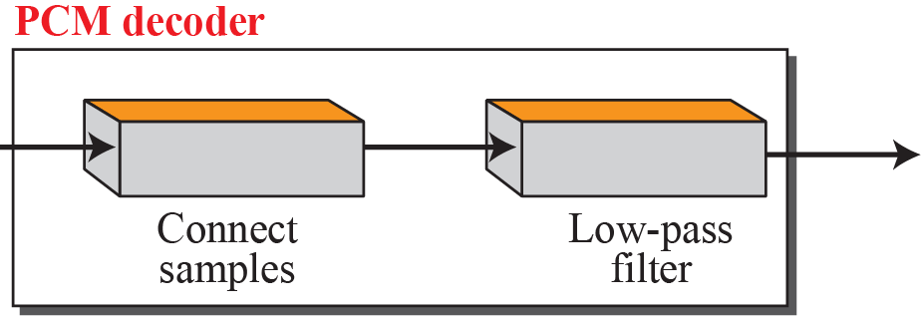
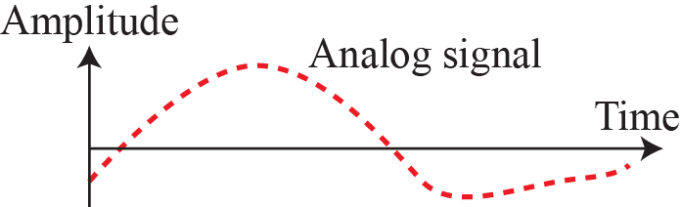
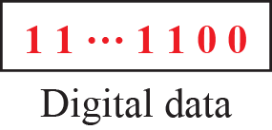
Original Signal Recovery- PCM Decoder

Slide 31
Analog-to-digital Conversion
Analog Data to Digital Data
Process of Digitization
Two techniques:
Pulse Code Modulation (PCM)
Delta Modulation (DM)

Slide 32
Delta Modulation (DM)
PCM is a very complex technique
Delta modulation is a simpler technique
PCM finds the value of the signal amplitude for each sample; DM finds the change from the previous sample
No code words

Slide 33
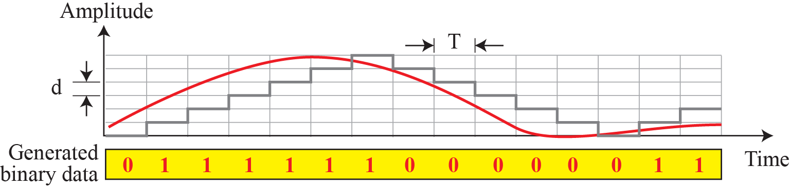
The process of delta modulation

Slide 34
Delta Modulation (DM)
Delta modulation is a simpler technique
DM finds the change from the previous sample
No code words

Slide 35
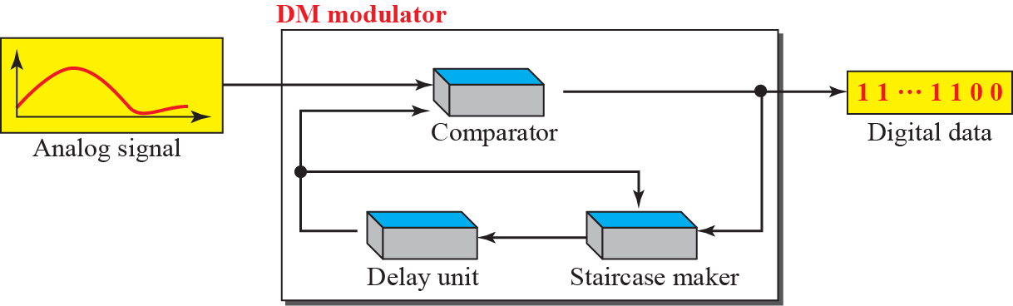
Delta Modulation Components

Slide 36
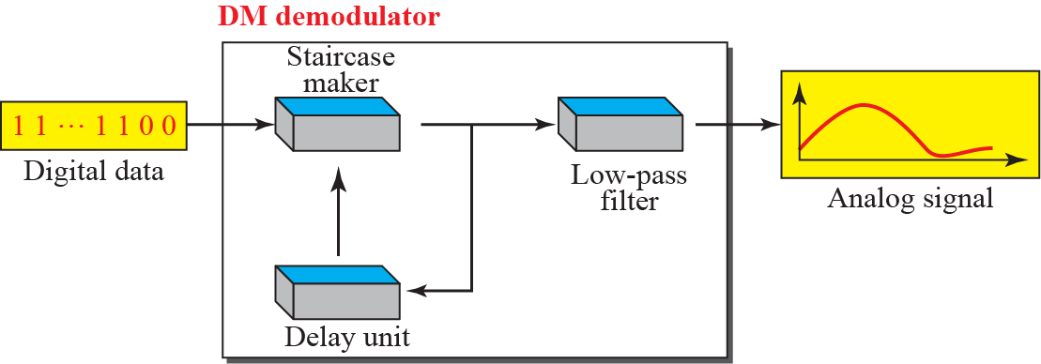
Delta Demodulation Components

Slide 37
Transmission Modes
Transmission of Data:
Wiring
Data Stream
Do we send 1 bit at a time; or do we group bits into larger groups and, if so, how?
Parallel or Serial Transmission

Slide 38
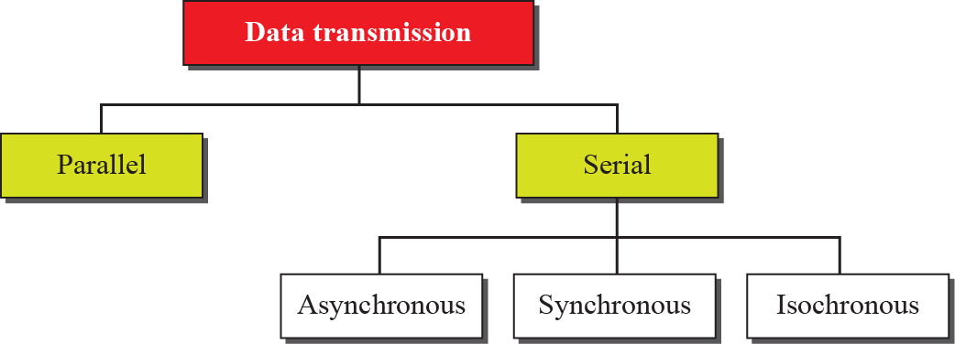
Data transmission modes

Slide 39
Parallel Transmission
Binary data (1s ad 0s) organized in groups of ‘n’ bits
We send ‘n’ bits at a time instead of just one
‘n’ wires required to send ‘n’ bits at one time

Slide 40
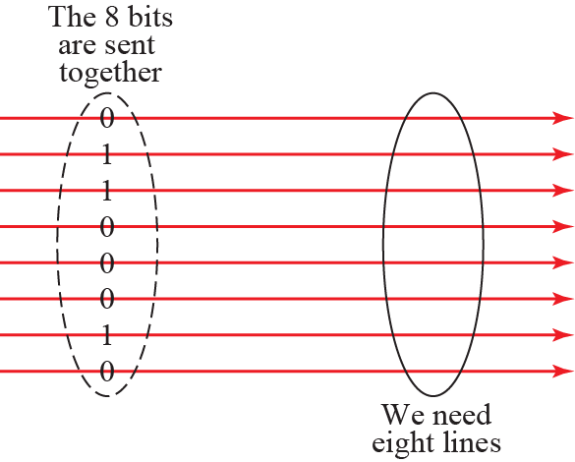


Parallel Transmission

Slide 41
Serial Transmission
In serial transmission one bit follows another
Only one communication channel rather than ‘n’ to transmit data

Slide 42
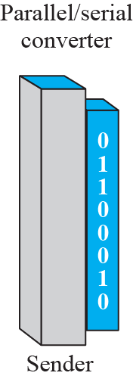
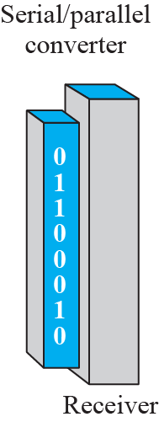
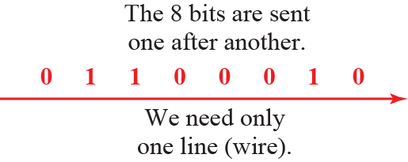
Serial Transmission

Slide 43
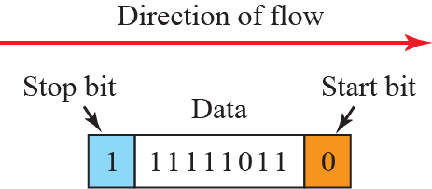

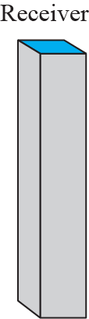
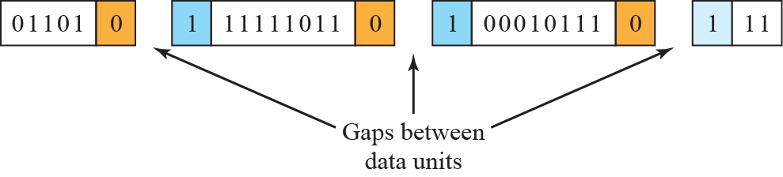
Asynchronous Transmission

Slide 44
Serial Transmission
In serial transmission one bit follows another
Only one communication channel rather than ‘n’ to transmit data

Slide 45


Synchronous Transmission

Slide 46
Isochronous Transmission
Real time Audio and Video
Synchronization between characters is not enough
Entire stream should be synchronized
Isochronous guarantees fixed rate data

